Slide 1

INCOME TAX GENERATOR
BY: DHRUVAL SHAH(16IT120)
SUBJECT: IT345 SOFTWARE GROUP PROJECT-2
SUPERVISOR: JALPESH VASA

Slide 2
CONTENTS
Introduction
Requirements
Introduction of Drupal
Why Drupal?
About Drupal 8
Features of Drupal 8
Work Flow
Conclusion
References

Slide 3
Introduction
Generally people contact income tax agent for help to solve and get income tax related details and even how many rupees of income tax they may pay to government will be told by agent .
People get their income tax based on their salary slip and 16H form by our website.
People also find income tax related latest news and updates in our website.
Also give details and help for pay income tax by own through official income tax pay link or income tax agent contact no and other details.

Slide 4
Requirements
Basics of php
CMS framework or php framework – DRUPAL 8
Basic information of income tax and income tax calculation , which parameters are use to calculate income tax
File concepts in php
Mysql Database

Slide 5
What is CMS?
CMS stands for Content Management System.
CMS provides capabilities for multiple users with different permission levels to manage web page (content) without the need to have HTML knowledge.
All information like content , article , comments ,user info etc store in database and retrive from database and manage on web pages without use of html.

Slide 6
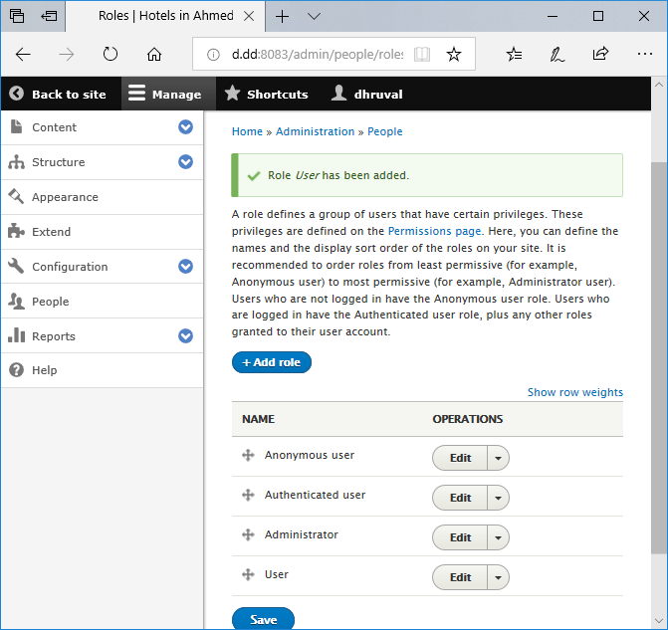

Slide 7
What is Drupal?
Drupal is open source content management software maintained and developed by a community of more than 35,000 developers around the world who have contributed to the project.
It is distributed under the terms of the GNU General Public License (or "GPL"), which means anyone is free to download it and share it with others.

Slide 8
Why is Drupal so widely used?
Put simply, it’s the quality of the software and the community behind it: hundreds and thousands of people around the world work on developing and maintaining the Drupal platform and ecosystem every second of every day.
This makes for an incredibly powerful, cuttingedge content management system (CMS).

Slide 9

What is Drupal 8?
Drupal 8 is the latest release on the Drupal journey, and one that is substantially more powerful than previous versions.
Drupal 8 provides new ways to tailor and deploy content that looks great on any device. However you work with Drupal, there is something in Drupal 8 for you to love.

Slide 10
Features of Drupal 8
New Theme Engine
Drupal 8 includes a brand new theming engine called Twig, which is PHP-based, flexible, fast, and secure. It's much easier to create beautiful and more functional Drupal websites using Twig, as its templates are written in a syntax that's less complex than a PHP template or others while being more secure.
Mobile First From The Get-Go
Drupal 8 is mobile first in its approach. All the built-in themes that come with Drupal 8 are responsive, along with an admin theme that adapts to different screen sizes, and a ‘Back To Site’ button to go back to the front page. Tables fit into any screen size without a hitch, and the new admin toolbar works well on mobile devices.

Slide 11
Continue..
Multilingual Ready
Drupal 8 boasts extensive multilingual features right out of the box. The admin interface has built-in translations. You can also create pages with language-based Views filtering and block visibility. Translation updates from the community are automatically facilitated.

Slide 12
Learn Drupal 8
Building basic site
Introduction of Drupal
Module Development
Extending and managing site
Layout & theming
Implement Problem using Drupal 8
Tasting
Final Modification if needed

Slide 13
Conclusion
From this website user can get all details of income tax like income tax amount , income tax guidelines , income tax agents , income tax recent updates and news very easily.
User friendly website
Easily register and get income tax amount

Slide 14
REFERENCES
https://community.acquiacademy.com/dashboard
https://www.drupal.org/documentation
https://www.drupal.org/download
https://dev.acquia.com/blog/learn-drupal-8-for-free-introduction-to-drupal-8/22/11/2016/17236
https://evolvingweb.ca/training/introduction-drupal-8
https://www.drupal.org/project/project_module

Slide 15
THANK YOU

